Slide 1
Recurrent Neural Networks
(Many figures adapted from Stanford CS230, MIT 6.S191, and Illinois CS 498)

Slide 2
Outline
What Are Recurrent Neural Networks?
When to Use RNN?
Types of RNNs
A Simple Example of RNN Model
How to Train Recurrent Neural Networks?
The Problem of Long-Term Dependencies
Long Short Term Memory (LSTMs)
Summary
有順序(sequence)的概念
ex: types的字有順序的概念，如果順序調換就沒有types的意義
CNN主要用在空間上
RNN主要用在時間上(例如文字順序的資訊)的資料

Slide 3
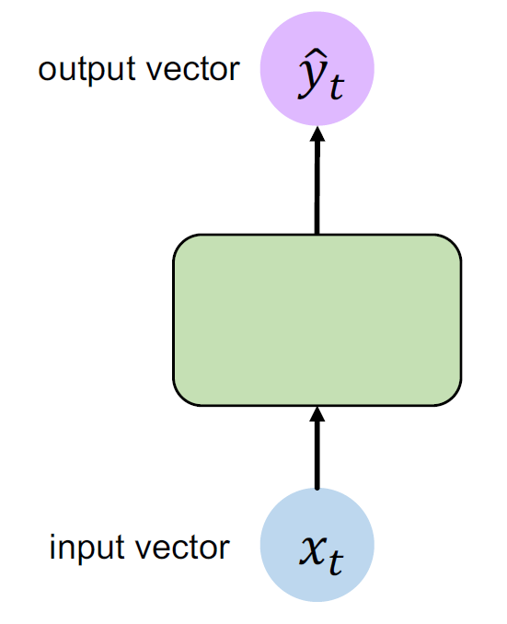
What Are Recurrent Neural Networks? (1/4)
Feedforward neural networks
The data flow in one direction from the input layer to the outputs.
They have no feedback loops.
輸出層
隱藏層
輸入層

Slide 4
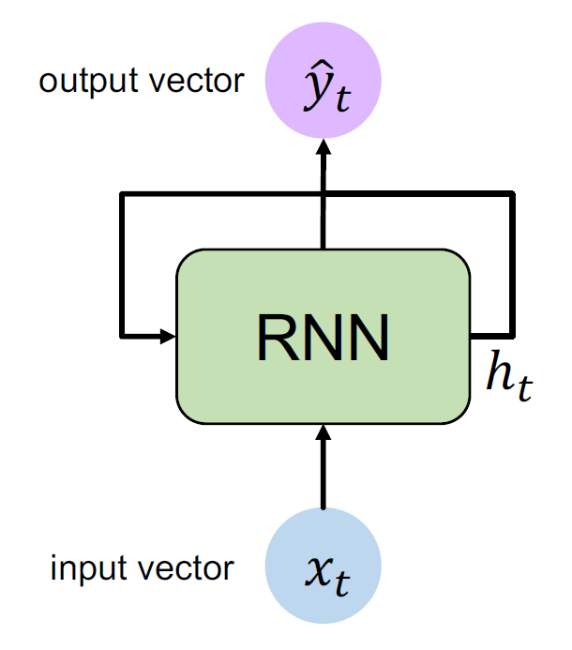
What Are Recurrent Neural Networks? (2/4)
Recurrent neural networks (RNNs)
RNNs use inputs from previous stages to help a model remember its past.
This is usually shown as a feedback loop on hidden units.
隱藏層還會再回傳

Slide 5
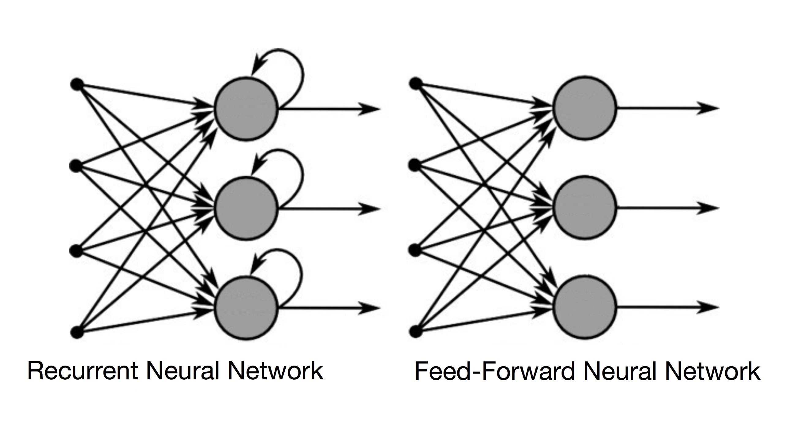
What Are Recurrent Neural Networks? (3/4)
Feeds the results back into the network

Slide 6
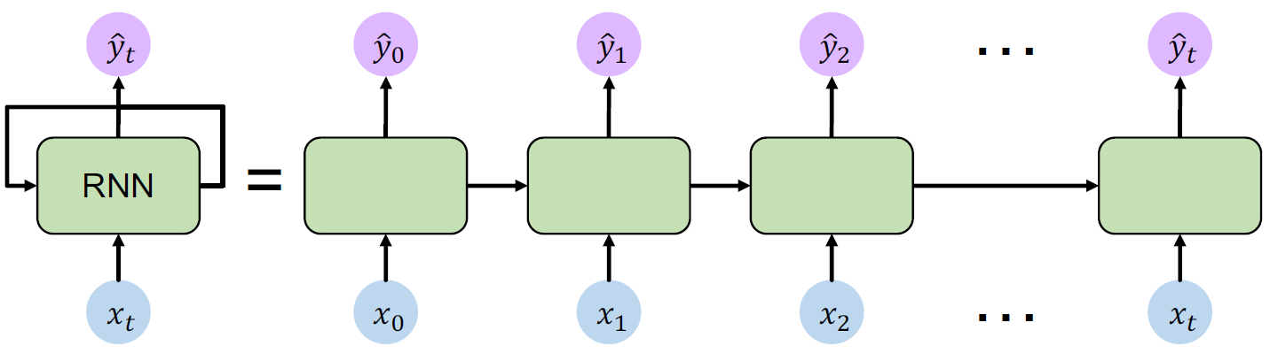
What Are Recurrent Neural Networks? (4/4)
The output of a layer is added to the next input and fed back into the same layer.
可以更了解A跟simple的關係
Ex: A simple的A
A simple的s
A simple的i
前人種樹後人乘涼
結合了到目前為止了解的資訊
h^(t-1)
h^t
把右邊的圖結合起來
第一個人沒有前面的資訊，我們寫h0的初始值為0(一般來說是向量)
An unrolled recurrent neural network
輸入層不是一口氣餵進去

Slide 7
When to Use RNN? (1/3)
If the patterns in the data changes with time(有時序性), then RNN is the choice.
More general, a problem requires to process a signal with a sequence structure.

Slide 8
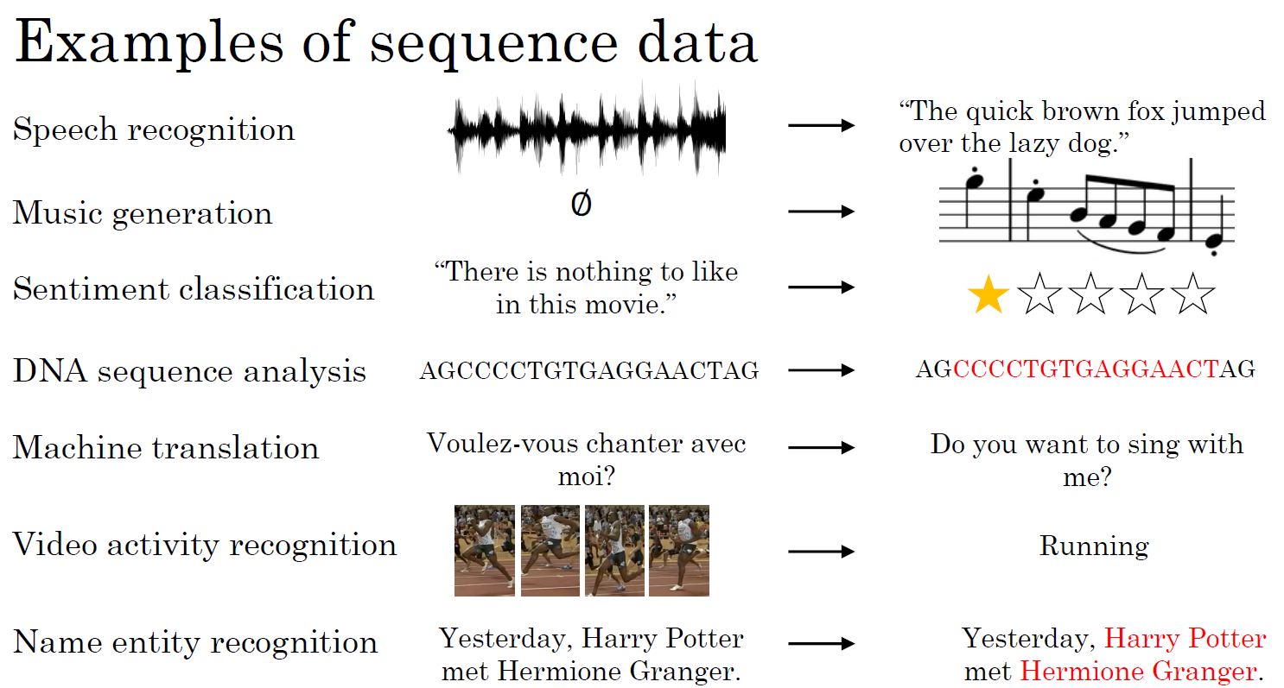
When to Use RNN? (2/3)
空集合
情緒

Slide 9
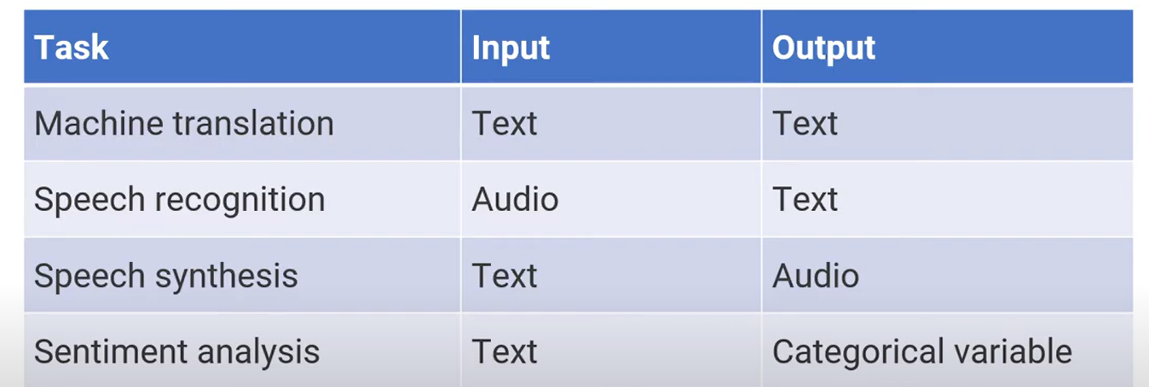
When to Use RNN? (3/3)
Types of inputs and outputs
影音的合成
(ex: input是文字，變成影音)

Slide 10

Types of RNNs (1/5)
Feed-forward Network
Music generation
Sentiment classification
Machine translation
Name entity recognition

Slide 11
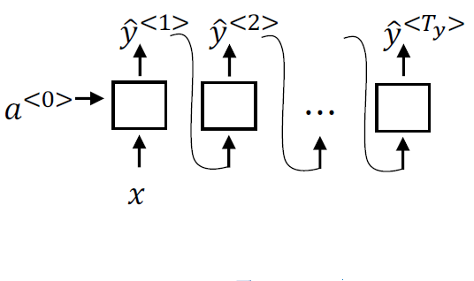
Types of RNNs (2/5)
Music generation
One to many (RNN)

Slide 12


Types of RNNs (3/5)
Sentiment Classification
Classifier
h₅
h₁
h₂
h₃
h₄
“The”
“food”
“was”
“really”
“good”
Many to one (RNN)

Slide 13
Types of RNNs (4/5)
Machine translation
“Matches”
“Nature”
“is”
“Correspondances”
“La”
“nature”
Many to many (RNN)
(or sequence to sequence)

Slide 14
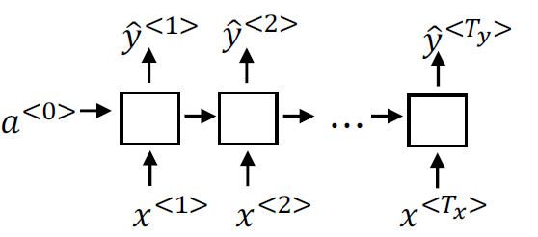
Types of RNNs (5/5)
Name entity recognition
Harry Potter and Hermione Granger invented a new spell
Many to many (RNN)

Slide 15
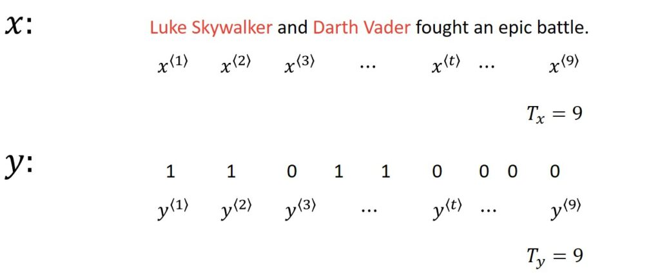
A Simple Example of RNN Model (1/8)
Name Entity Recognition

Slide 16
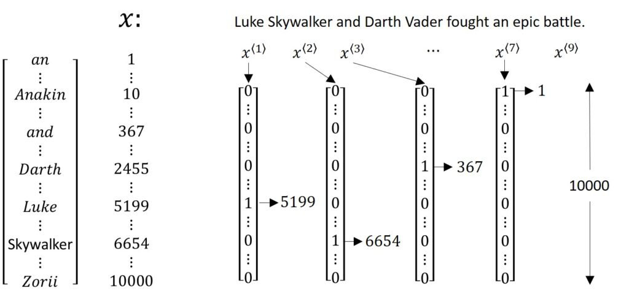
A Simple Example of RNN Model (2/8)

Slide 17
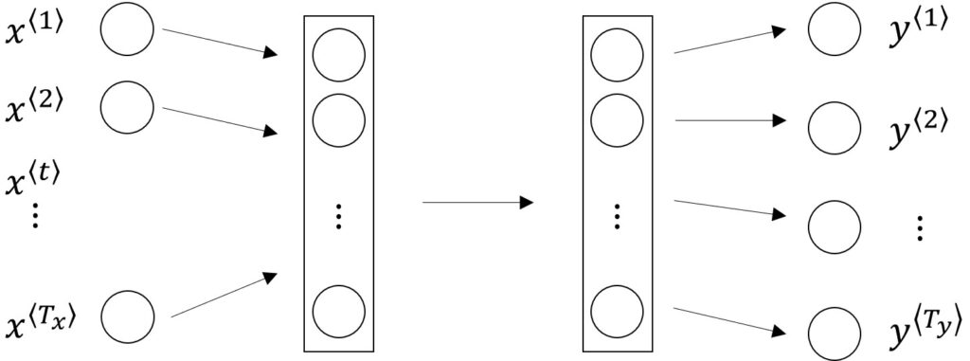
A Simple Example of RNN Model (3/8)
Why not a standard network?
Problems:
Inputs, outputs can be different lengths in different examples.
Doesn’t share features learned across different positions

Slide 18
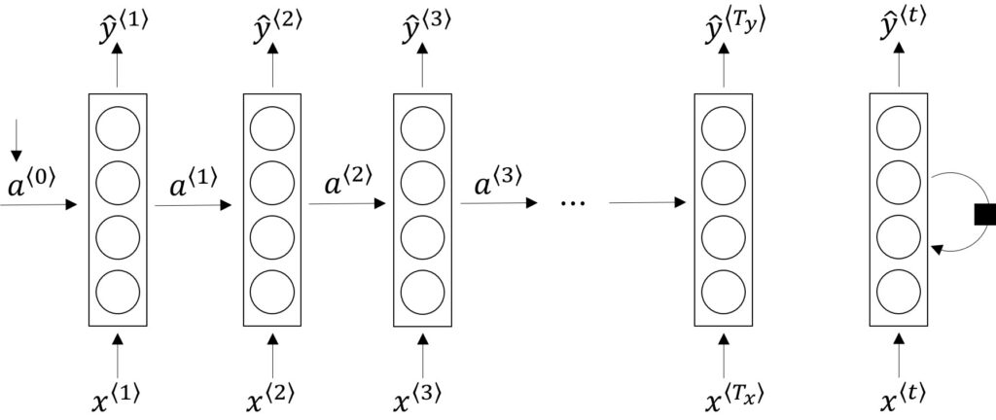
A Simple Example of RNN Model (4/8)
The architecture of an RNN model
An unrolled recurrent neural network
RNN with loop

Slide 19
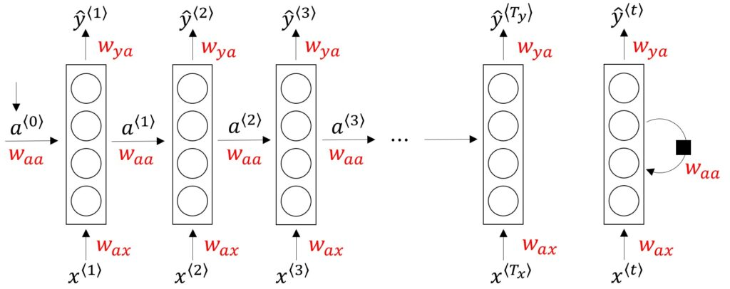
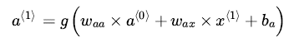
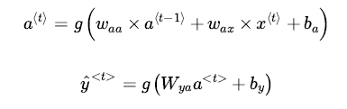
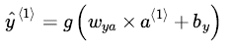
A Simple Example of RNN Model (5/8)
Forward Propagation

Slide 20
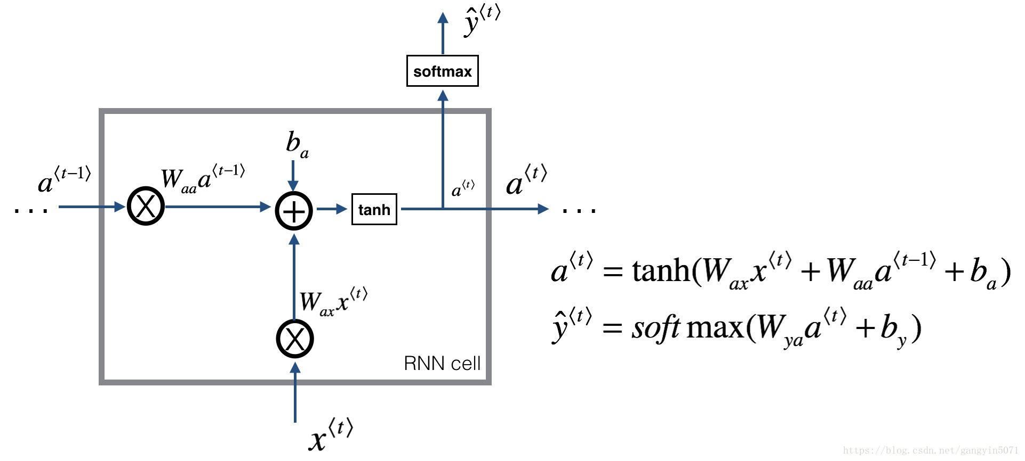
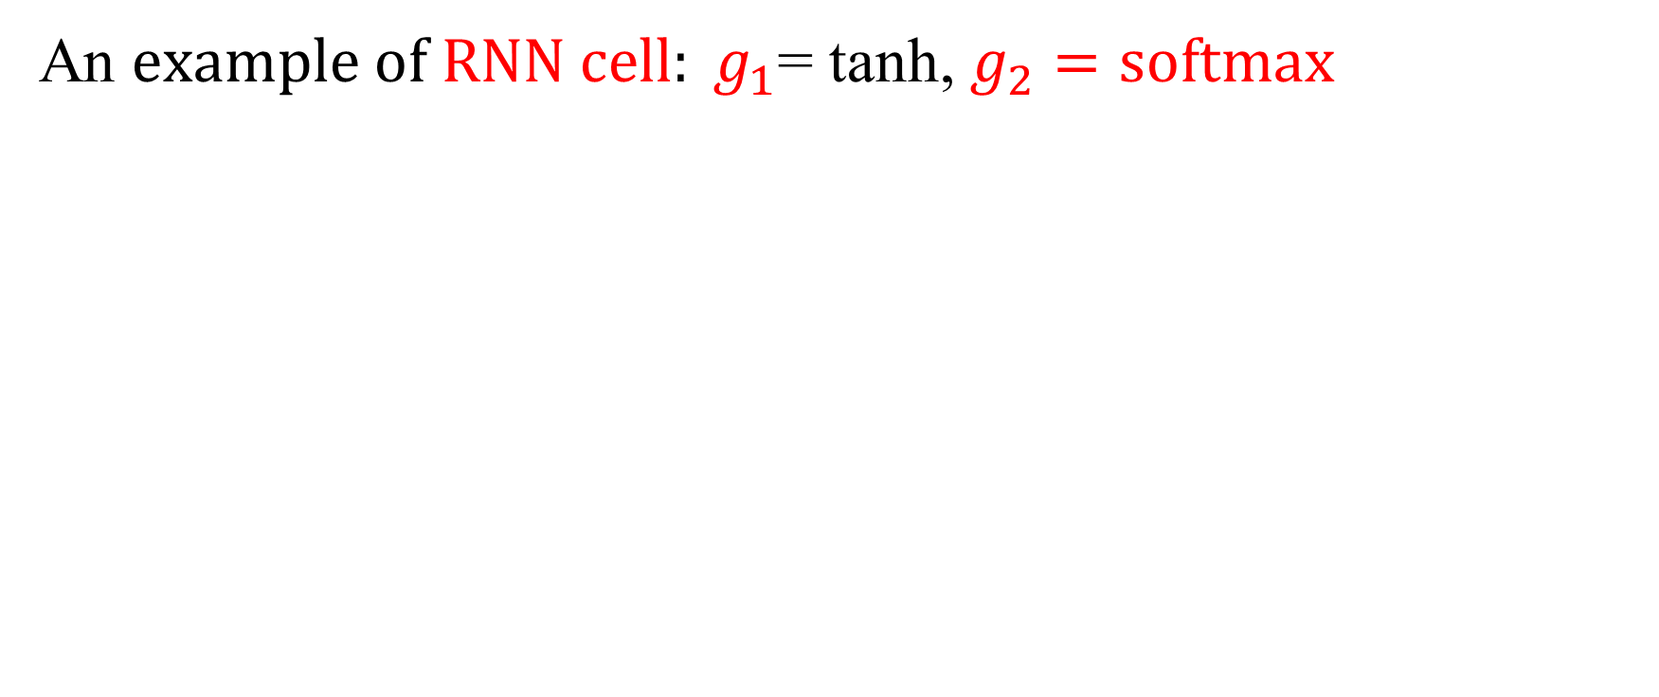
A Simple Example of RNN Model (6/8)
An $example of RNN cell: g_{1}$= tanh, $g_{2}=softmax$

Slide 21
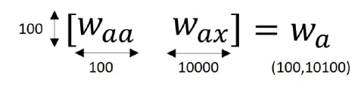
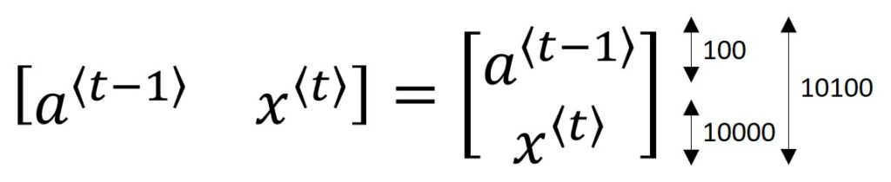
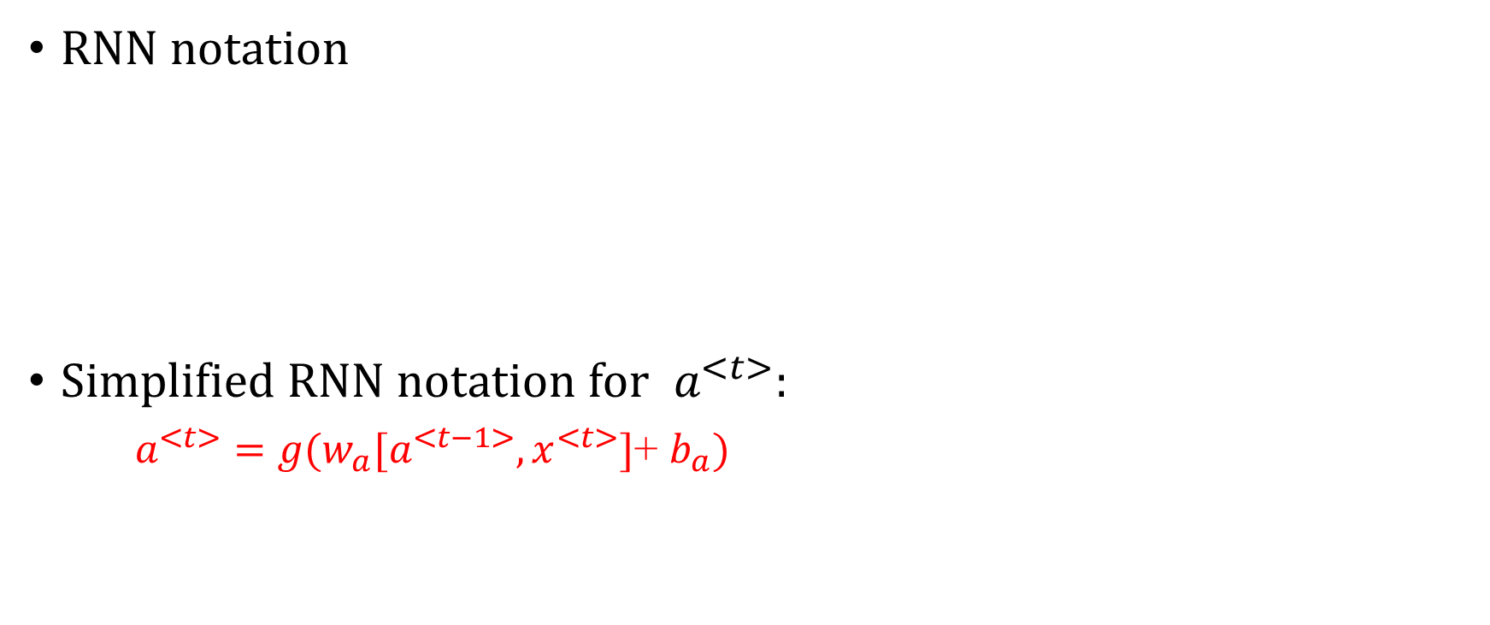
A Simple Example of RNN Model (7/8)
RNN notation
Simplified RNN notation for $a^{<t>}$:
$a^{<t>}=g(w_{a}[a^{<t−1>},x^{<t>}]$+ $b_{a})$
g 是 activation function

Slide 22
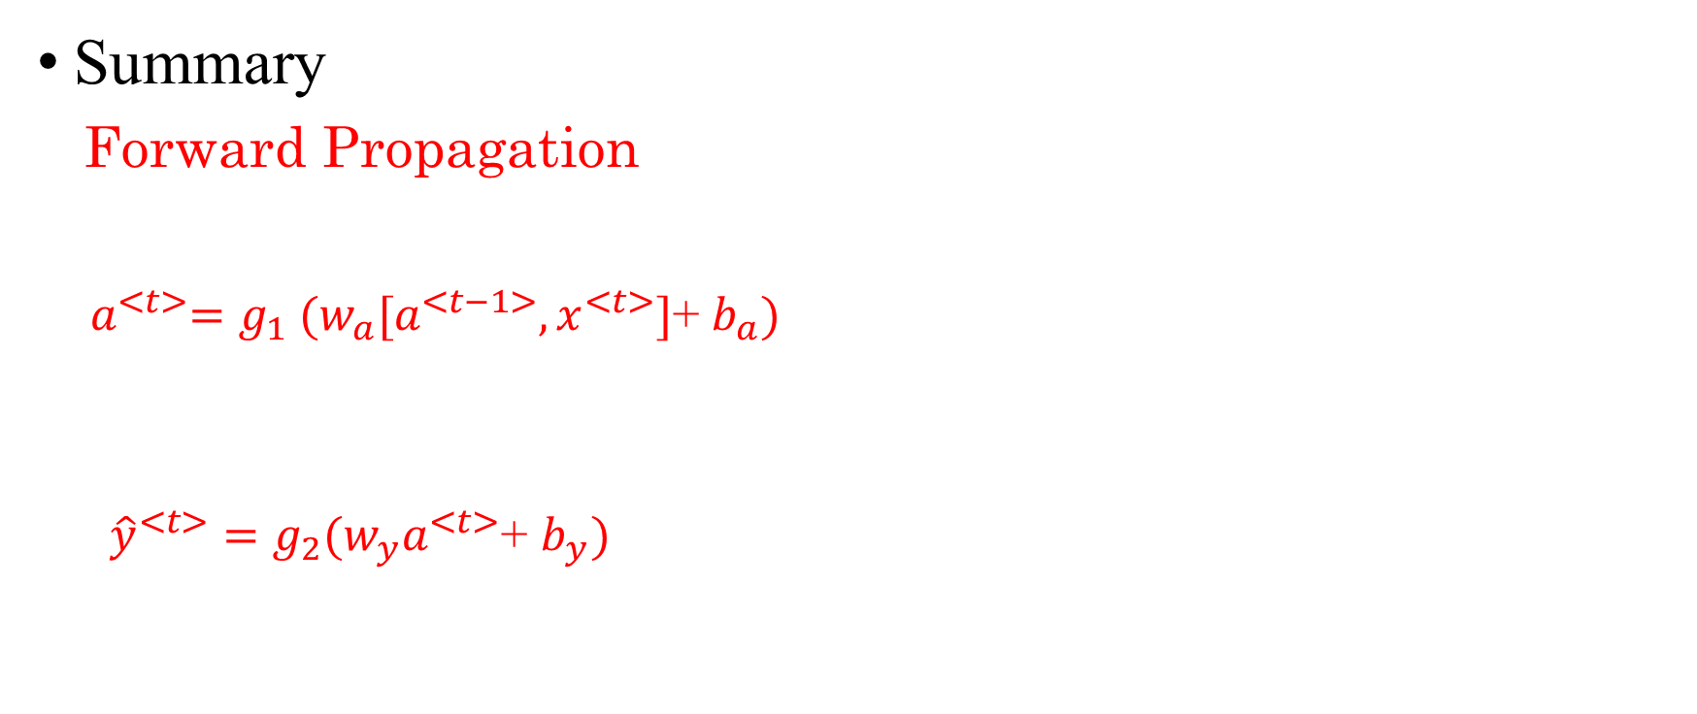
A Simple Example of RNN Model (8/8)
Summary
Forward Propagation
${ a}^{<t>}=g_{1} (w_{a}[a^{<t−1>},x^{<t>}]$+ $b_{a})$
${\hat{y}}^{<t>}=g_{2}(w_{y}a^{<t>}$+ $b_{y})$

Slide 23
How to Train Recurrent Neural Networks? (1/3)
Recurrent neural networks use backpropagation algorithm for training, but it is applied for every timestamp.
It is commonly known as Backpropagation Through Time (BPTT).

Slide 24
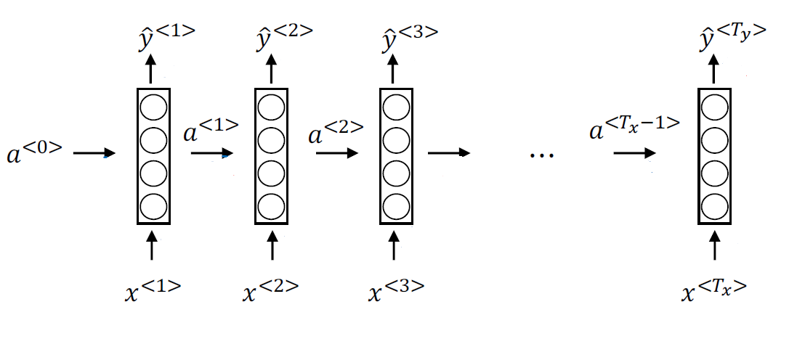
How to Train Recurrent Neural Networks? (2/3)
Forward propagation (→) and backpropagation (→)

Slide 25
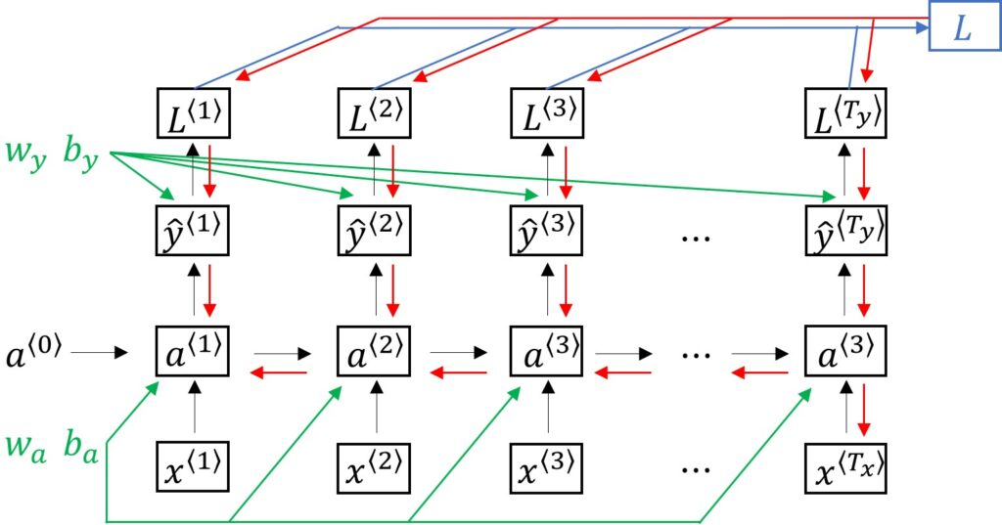
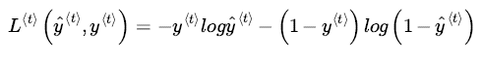
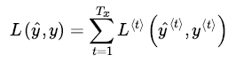
How to Train Recurrent Neural Networks? (3/3)
Backpropagation Through Time (BPTT)

Slide 26
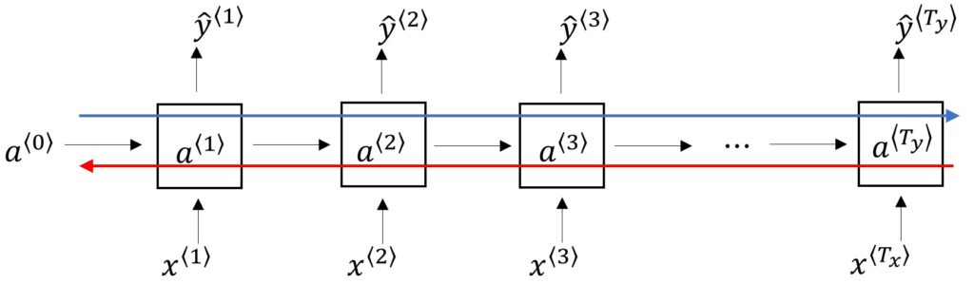
The Problem of Long-Term Dependencies (1/3)
RNN的問題
Why are vanishing gradients a problem?
Multiply many small numbers together
Errors due to further back time steps have smaller and smaller gradients
Note:
For the exploding gradients problem, use gradient clipping to scale big gradients.
Influence parameters to capture short-term dependencies

Slide 27
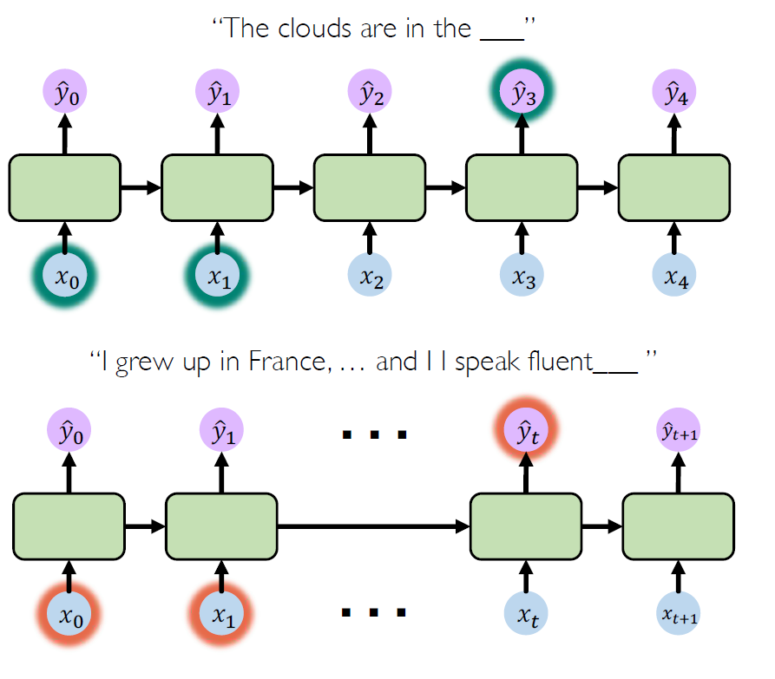
The Problem of Long-Term Dependencies (2/3)
RNN may work out for this short-term dependency case
RNN may cause a problem for this long-term dependency case

Slide 28
The Problem of Long-Term Dependencies (3/3)
Two popular RNN architectures:
Long Short-Term Memory Networks (LSTMs)
Gated Recurrent Units (GRUs)
Both aim to remember long-term dependencies while alleviating the vanishing and exploding gradient problems.
These architectures use gated modules to keep what's important in a sequence of data points.

Slide 29
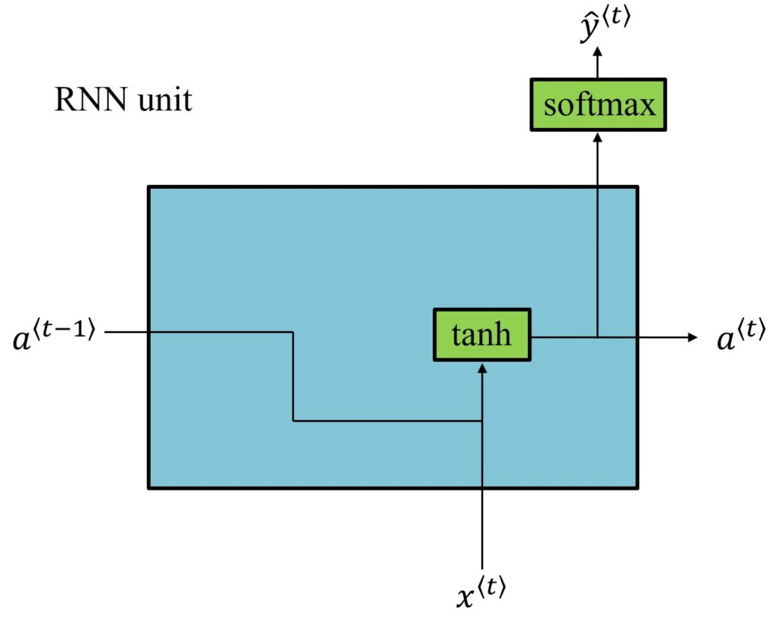
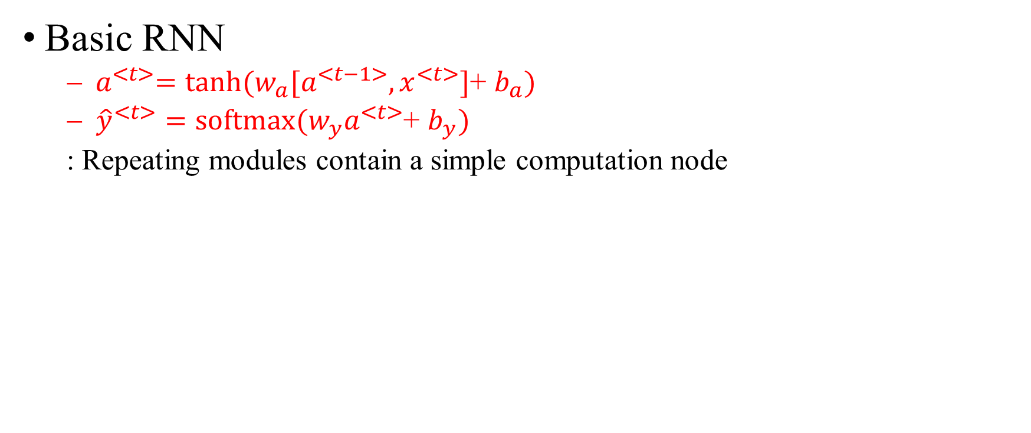
Long Short Term Memory (LSTMs)
Basic RNN
${ a}^{<t>}=tanh(w_{a}[a^{<t−1>},x^{<t>}]$+ $b_{a})$
${\hat{y}}^{<t>}=softmax(w_{y}a^{<t>}$+ $b_{y})$
: Repeating modules contain a simple computation node

Slide 30
Long Short Term Memory (LSTMs)
Basic RNN (New Notation)

Slide 43
LSTMs: key concepts
Maintain a separate cell state from what is outputted
Use gates to control the flow of information
Forget gate gets rid of irrelevant information
Store relevant information from current input
Selectively update cell state
Output gate returns a filtered version of the cell state

Slide 44
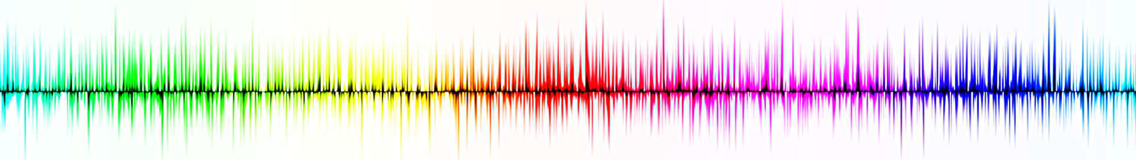
Summary
RNNs are well suited for sequence modeling tasks
Model sequences via a recurrence relation
Training RNNs with backpropagation through time
Gated cells like LSTMs let us model long-term dependencies
Models for music generation, classification, machine translation

Slide 45
Resources
Stanford CS230: Deep Learning
MIT 6.S191: Introduction to Deep Learning
Illinois CS 498: Introduction to Deep Learning

